Slide 1

6.2-Tunnel Engineering
JAIN POLYTECHNIC, BELAGAVI
15CE54T – Transportation Engineering
Presented by: Abhishek Amathe, L/CE

Slide 2
CONTENT
Transferring alignment inside the tunnel
Size and shapes of tunnels
Mucking
Concept of shafts
Objects of tunnel lining
Ventilation and drainage in tunnels

Slide 3
TRANSFERRING ALIGNMENT INSIDE THE TUNNEL
Central line transference to the Inside of the Tunnel
This operation is very important as the alignment entirely depends upon this operation.
It must be done carefully. This work needs utmost care and accuracy in execution. If it is not done carefully, centre line worked from opposite faces will not meet.
Thus deviation in centre line will cause over breaking resulting in additional expenditure especially when the tunnelling is done in hard rock.

Slide 4
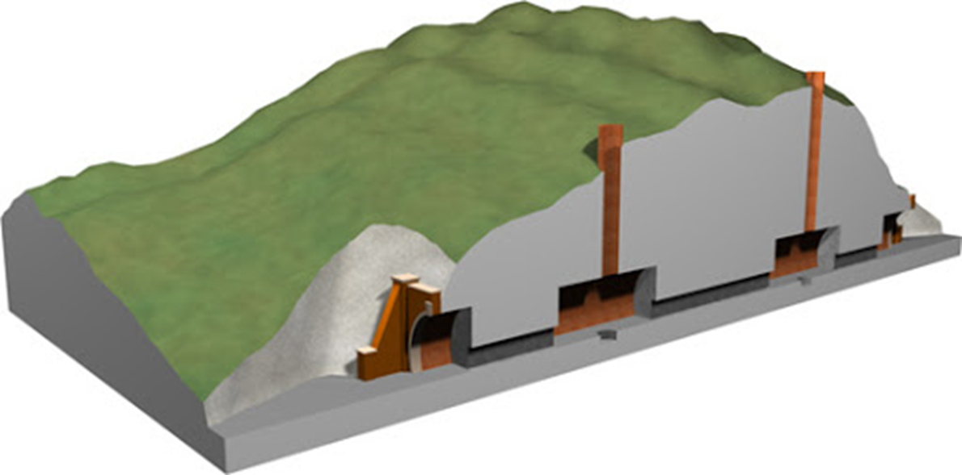
Centre line on ground

Slide 5
TRANSFERRING ALIGNMENT INSIDE THE TUNNEL
Procedure:
Two plumb-bobs attached to fine wires are suspended in the shaft.
In the tunnel these plumb-bobs are immersed in water or oil buckets, so that they may not be affected by vibrations.
With the help of a theodolite these wires are brought on centre-line at the ground.
When the wires at top are lying on centre line, they will automatically be on centre line in the shaft also.
Now one theodolite is kept about 7 metres away from wires in such a way that, when observing through the telescope both wires are in one line. In this position the axis of telescope will i.e. in the centre line of the tunnel.
The construction of the tunnel in one or both the directions started along the centre-line, which has been fixed by driving the pegs in the roof of the tunnel rid suspending plumb-bobs

Slide 6

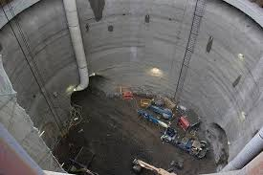
SHAFT
Shafts are vertical tunnels or wells or passages, reaching from the ground surface down to the tunnel invert.
They afford manifold advantages and are used in constructing tunnels. When the position and course of the tunnel are correctly aligned and accordingly set out on the surface, shafts are sunk at suitable points on this tunnel line to aid tunnelling operations.

Slide 7
SHAFT
Classification of shafts
Depending upon the position, the shafts are classified as follows :
Vertical shafts
Inclined shafts
Permanent shafts
Temporary shafts

Slide 8
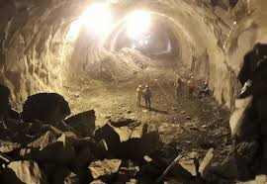
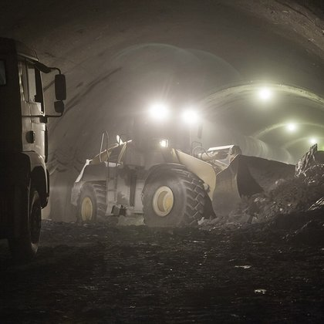
MUCKING
Mucking is removal of the blasted debris or spoil from the tunnel interior to sites outside the tunnel entrance.
In all big tunnel conductions, this is to be reckoned as a major item of expenditure and efficient and quick removal of muck minimises working costs.

Slide 9
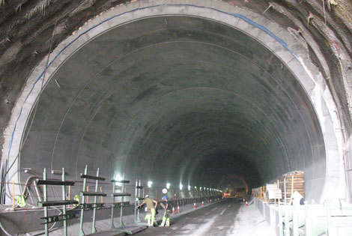
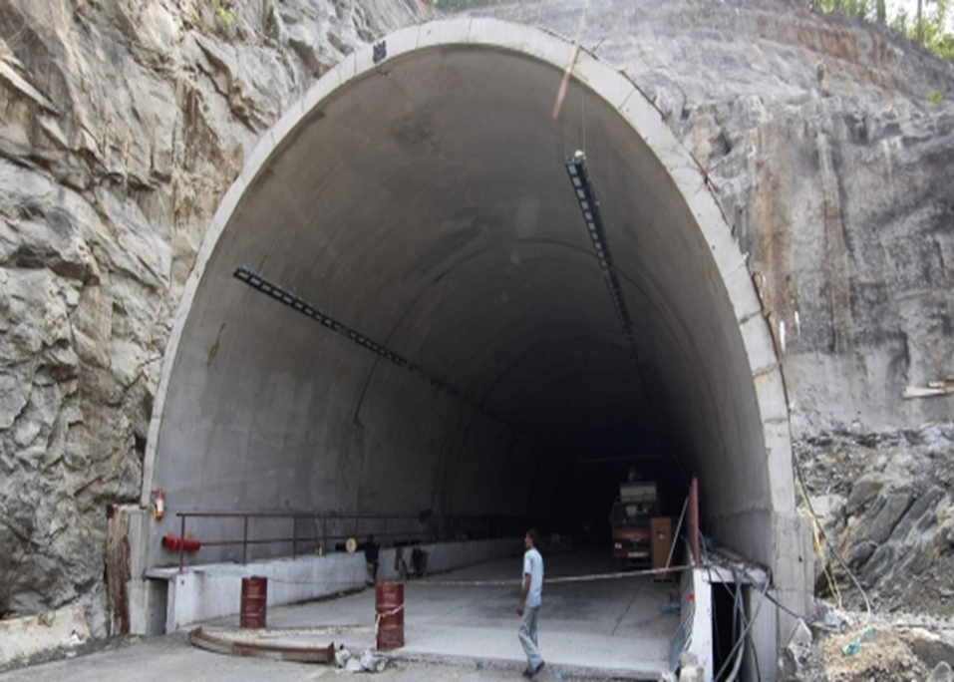
TUNNEL LINING
Lining is the operation of providing impervious layer to give shape to the tunnel cross-section and to give strength to the side and roof to prevent them from collapsing.
If the tunnel is subjected to internal or external or heavy ground pressure, the provision of lining will result in the increase of strength of the tunnel C/S

Slide 10
VENTILATION OF THE TUNNELS
Ventilation of the tunnel is the provision of sufficient quantity of fresh air in the Tunnel so that workmen in the tunnel may not feel discomfort.
Ventilation helps to bring down the rise in temperature inside the tunnel.
METHODS OF VENTILATION
Any one of the following methods may be employed for providing ventilation in the tunnels :
l. Natural methods
2. Mechanical methods

Slide 11
VENTILATION OF THE TUNNELS
l. Natural methods
Fresh ventilation to the workers in the tunnel is provided from the drift driven between the portals (From one portal to the other).
On account of difference of temperature between inside and outside of the tunnel natural ventilation is provided. It will be effective if the orientation of the tunnel is along the direction of the wind.
Natural ventilation can be improved by providing shafts at a suitable interval along the alignment of a tunnel during its construction.

Slide 12
VENTILATION OF THE TUNNELS
2. Mechanical methods
Blowing: In this method, fresh air is blown by blower fans. The fans are mounted in one or more input shafts. The foul air is forced out through the portals.
Exhausting: This is also referred as 'Vacuum Process' and in this method, foul air and dust are taken out into an exhausting duct near the working face thus creating a flow of fresh air into the tunnel from the portal or inlet-shafts.

Slide 13
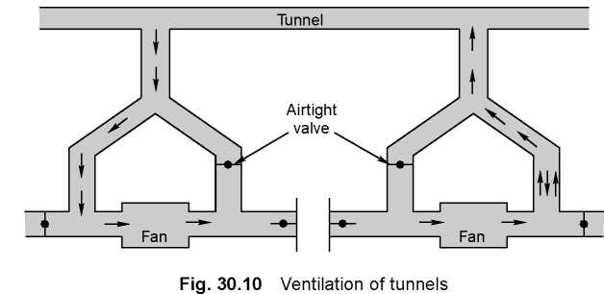
VENTILATION OF THE TUNNELS
c. Combination of blowing and exhausting: In this method, blower and exhaust fans are provided for providing fresh air in the tunnel and sucking foul air from the tunnel respectively.

Slide 14
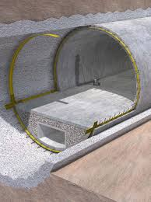
DRAINAGE OF TUNNELS
The art of collection and removal of water entering the tunnels during and after their construction is known as drainage of tunnels.
Generally at the time of construction the water which is used for wet drilling and which comes through seepage is removed by pumps.
After the completion of the tunnel the water is taken out by means of open drains provided in the centre or both sides of the tunnel by gravitational force.
Sufficient slope is provided in the drains to take out water from the tunnel.

